Slide 1
Project Presentation of CO-OP Project at Industry (Module-2) (22CS421)
On
AI-Agent Driven Personalized Outreach System Using n8n
By
Shivean Gupta (2210992332)
Supervised By
Saurabh Vohra (Marketing Manager), KocharTech
Department of Computer Science and Engineering,
Chitkara University, Punjab

Slide 2
Introduction
Why Personalized Outreach Matters?
The Problem:
Most "personalized" cold emails just swap in a first name and company. Recipients see through it instantly and stop reading. Real personalization means understanding what someone cares about and writing around that.
The Scale Challenge:
Researching one lead manually took us 18 minutes. For 100 leads, that is 30+ hours of prep work. Conventional tools like HubSpot send at volume but follow rules, not reasoning.
Our Approach:
Built a pipeline of 4 AI agents in n8n. Each agent handles one stage: profile research, company research, angle identification, and email drafting. Feed it a LinkedIn URL, get a personalized draft in under 3 minutes.
2

Slide 3
Problem Statement
Existing cold email automation relies on fixed templates and merge fields. It cannot reason about a contact's actual situation or write context-aware messages.
Manual research produces better emails but takes 18 min/lead. Not sustainable at any meaningful scale.
Enterprise platforms (HubSpot, Marketo, Salesforce) handle inbound nurturing well, but for cold outreach to strangers with no behavioral data, they offer little beyond template delivery.
LLMs can write good emails, but the quality depends entirely on the context fed to them. A name and title produces generic output. A detailed research summary produces something completely different.
The gap: no published system that systematically gathers prospect-specific context and feeds it to an LLM for email generation at scale.
3

Slide 4
Objective and Solution
What this project aims to achieve:
1. Build a multi-agent pipeline that breaks outreach prep into four distinct agent-handled stages with strict input/output formats.
2. Evaluate the system on real campaign data from 300 leads, comparing AI-generated outreach against manual workflows.
3. Create a fully reproducible setup using n8n, GPT-4o, Apollo.io, and Lemlist with no custom backend.
Four specialized AI agents orchestrated via n8n:
Person Research Agent extracts role context and priorities from LinkedIn.
Company Research Agent pulls company context from public web sources.
Mission Agent reasons about fit and returns 2-3 outreach angles.
Email Drafting Agent generates primary email + 2 follow-ups.
Human reviewer approves every draft via Lemlist before sending.
4

Slide 5
Methodology
System Architecture and Approach
1. Data Source:
Apollo.io API provides structured lead data (name, email, title, company size). LinkedIn profiles supply role context.
2. Agent Pipeline:
Two-layer architecture: ABM Brain (coordinator) + 4 execution agents running sequentially. Strict JSON input/output between stages.
3. Prompt Engineering:
Prompts versioned and tested like code. Key insight: "write as if you already know something specific" transformed output quality.
4. Deployment:
Lemlist handles email delivery and tracking. Human review gate before activation. Batch mode for bulk campaigns.
5

Slide 6
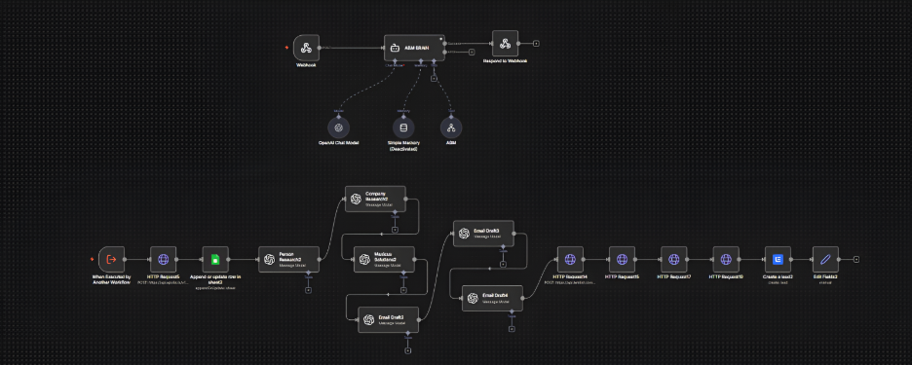
System Architecture
n8n Workflow: 21 Nodes, Full Pipeline
6

Slide 7
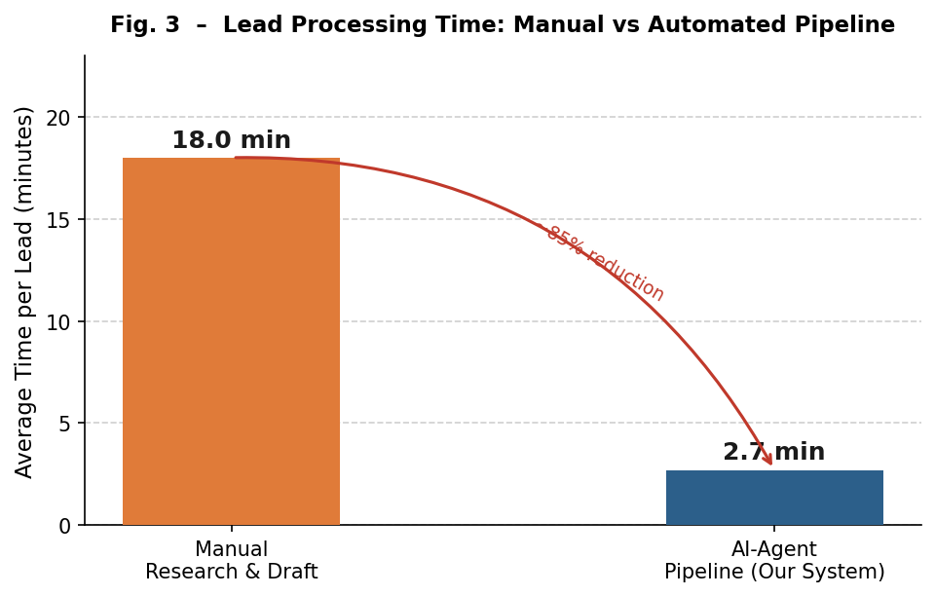
Results: Phase 1
RESULTS: Phase 1 (30 Leads, A/B Test)
Draft Time:
18.0 min (manual) vs. 2.7 min (pipeline) = 85% reduction in prep time.
Personalization Score:
4.1/5 (automated) vs. 3.8/5 (manual). Automated drafts anchored on verifiable company details.
Intervention Rate:
23% (automated) vs. 18% (manual). Most edits were stylistic, about 4% were factual corrections.
7

Slide 8
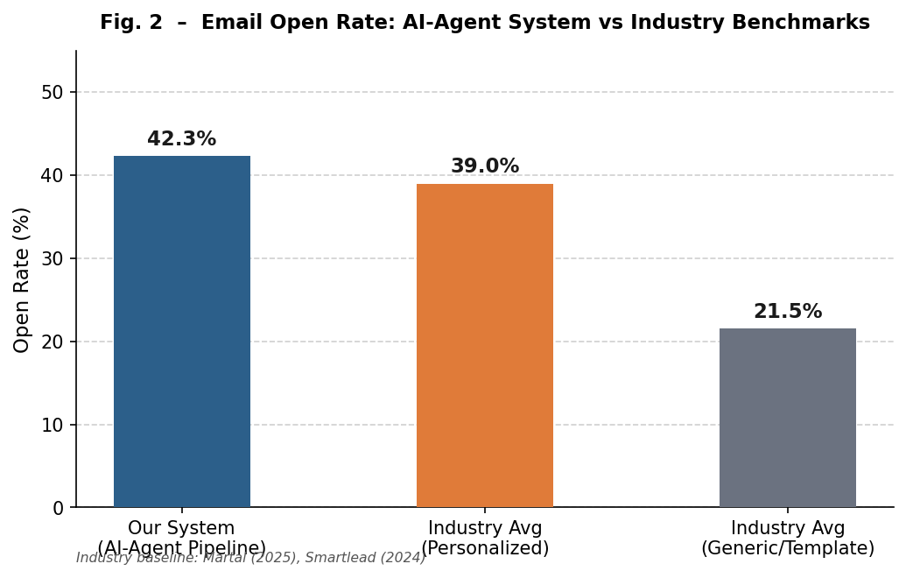
Results: Phase 2
RESULTS: Phase 2 (300 Leads, Full Deployment)
Open Rate: 42.3%
Beat the industry benchmark of 39% for personalized B2B cold outreach. Subject lines referenced specific company initiatives.
Reply Rate: 0.67% (2 replies)
Campaign cut short before full 3-email sequence completed. Both replies came from leads who received 2+ emails.
Delivery: 291/300 (97.0%)
Processing: 2.7 min/lead vs. 18 min manual
8

Slide 9
Conclusion and Future Scope
CONCLUSIONS
The bottleneck in personalized outreach is preparation, not writing. When agents handle the research, drafting becomes almost easy.
42.3% open rate beat industry benchmarks. Agent decomposition itself improved quality beyond what any single model could achieve.
The system is reproducible with off-the-shelf tools. No custom backend needed.
FUTURE WORK
Confidence scoring to prioritize review for low-confidence drafts.
Feedback loop from reviewer edits back into prompt refinement.
Domain-specific prompt variants for industries beyond SaaS.
Parallelized batch processing for thousands of leads.
9

Slide 10
Thank You
10

